Slide 1
Unit -3 Storage Fundamentals

Slide 2
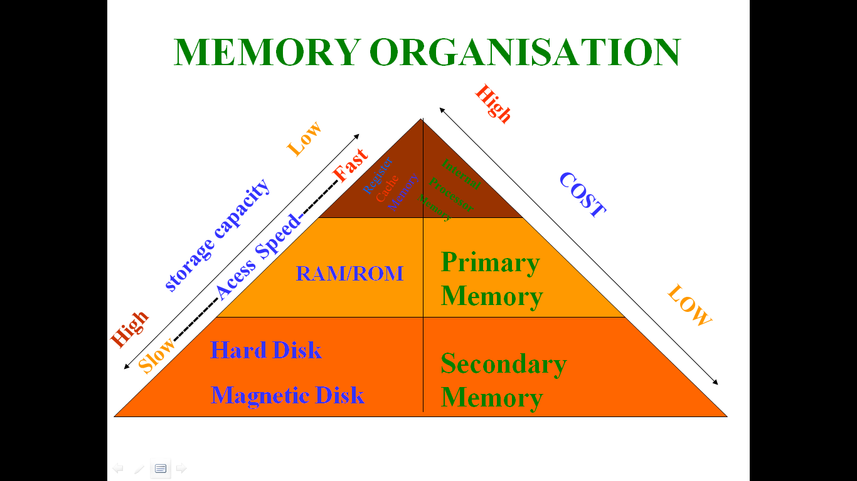

Slide 3
Memory capacity
1 bit (binary digit*) = the value of 0 or 1
8 bits = 1 byte
1024 bytes = 1 kilobyte
1024 kilobytes = 1 megabyte
1024 megabytes = 1 gigabyte
1024 gigabytes = 1 terabyte
1024 terabytes = 1 petabyte
Abbreviations
1 kilobyte = 1 k
1 megabyte = 1 MB
1 gigabyte = 1 GB
1 terabyte = 1 TB
1 petabyte = 1 PB
Size in "bytes"
Kilobyte (KB) = 1,024
Megabyte (MB) = 1,048,576
Gigabyte (GB) = 1,073,741,824
Terabyte (TB) = 1,099,511,627,776
Petabyte (PB) = 1,125,899,906,842,624

Slide 4
Types of Computer Memory's:
1. Main memory /Primary Memory / Volatile Memory.
2. Secondary Memory / Non Volatile Memory.

Slide 5
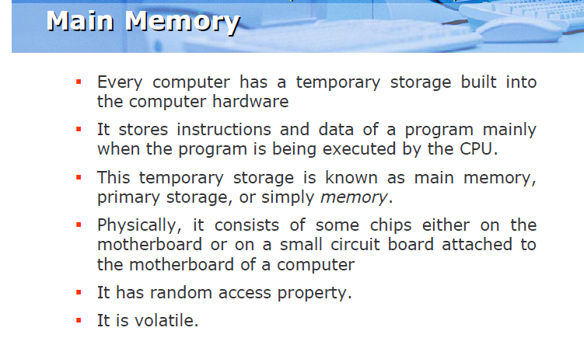

Slide 6
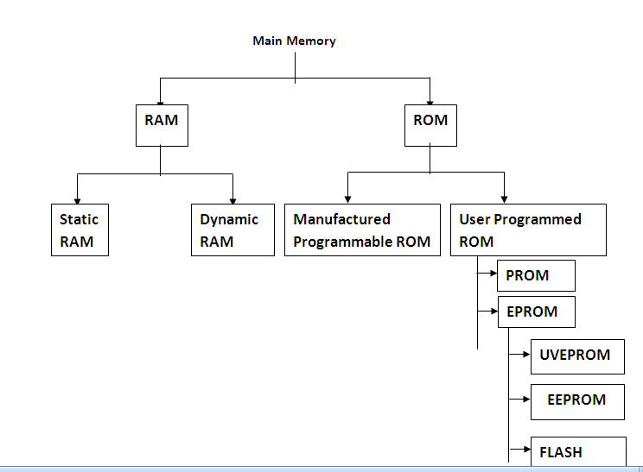

Slide 7
Random Access Memory (RAM):
The primary storage is referred to as random access memory (RAM) because it is possible to randomly select and use any location of the memory directly store and retrieve data. It takes same time to any address of the memory as the first address.

Slide 8
It is also called read/write memory. The storage of data and instructions inside the primary storage is temporary. It disappears from RAM as soon as the power to the computer is switched off. The memories, which lose their content on failure of power supply, are known as volatile memories. Physically , this memory consists of some integrated Circuit (IC) chips on the motherboard or on a small circuit board attached to the motherboard

Slide 9
RAM categorized into following types.
DRAM – Dynamic RAM :
Dynamic RAM: loses its stored information in a very short time (for milli sec.) even when power supply is on.
D-RAM’s are cheaper & lower. This refresh operation is where dynamic RAM gets its name. Dynamic RAM has to be dynamically refreshed all of the time or it forgets what it is holding. The downside of all of this refreshing is that it takes time and slows down the memory.

Slide 10
SRAM – Static RAM
Static RAM uses a completely different technology. S-RAM retains stored information only as long as the power supply is on. Static RAM’s are costlier and consume more power. They have higher speed than D-RAMs. They store information in Hip-Hope.

Slide 11
Some other RAMS are :
SDRAM (Synchronous DRAMS), SGRAMs (Synchronous Graphic RAMs) These RAM chips use the same clock rate as CPUuses. They transfer data when the CPU expects them to be ready.
DDR-SDRAM (Double Data Rate – SDRAM) : This RAM transfers data on both edges of the clock. Therefore the transfer rate of the data becomes doubles.
DDR4 SDRAM is the abbreviation for "double data rate fourth generation synchronous dynamic random-access memory", the latest variant of memory in computing. DDR4 is able to achieve higher speed and efficiency .

Slide 12
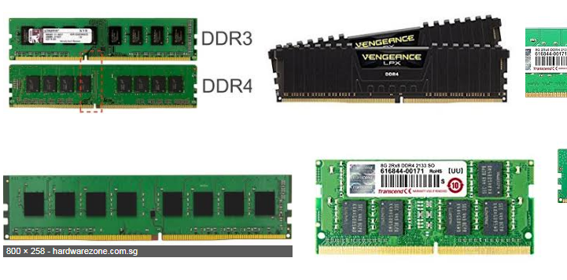

Slide 13
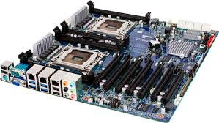

Slide 14
Read Only Memory (ROM):
There is another memory in computer, which is called Read Only Memory (ROM). The storage of program and data in the ROM is permanent. The ROM stores some standard processing programs supplied by the manufacturers to operate the personal computer. The ROM can only be read by the CPU but it cannot be changed. The basic input/output program is stored in the ROM that examines and initializes various equipment attached to the PC when the power switch is ON. The memories, which do not lose their content on failure of power supply, are known as non-volatile memories. ROM is non-volatile memory.

Slide 15
Types of ROM
PROM: There is another type of primary memory in computer, which is called Programmable Read Only Memory (PROM). You know that it is not possible to modify or erase programs stored in ROM, but it is possible for you to store your program in PROM chip. Once the programmers’ are written it cannot be changed and remain intact even if power is switched off. Therefore programs or instructions written in PROM or ROM cannot be erased or changed.

Slide 16
EPROM: This stands for Erasable Programmable Read Only Memory, which overcome the problem of PROM . EPROM chip can be programmed time and again by erasing the information stored earlier in it. Information stored in EPROM exposing the chip for some time ultraviolet light and it erases chip is reprogrammed using a special programming facility. When the EPROM is in use information can only be read.

Slide 17
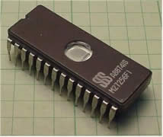
EEPROM- It stands for Electrically Erasable Read Only Memory. These are also erasable like EPROM, but the same work of erasing is performed with electric current. Thus, it provides the ease of erasing it even if the memory is positioned in the computer. It stores computer system’s BIOS. Unlike EPROM, the entire chip does not have to be erased for changing some portion of it. Thus, it even gets rid of some biggest challenges faced by using EPROMs.

Slide 18
Cache Memory: A Cache (Pronounced as “cash”) is a small and very fast temporary storage memory. It is designed to speed up the transfer of data and instructions. It is located inside or close to the CPU chip. It is faster than RAM and the data/instructions that are most recently or most frequently used by CPU are stored in cache.
As the microprocessor processes data, it looks first in the cache memory; if it finds the instructions there (from a previous reading of data), it does not have to do a more time-consuming reading of data from larger memory or other data storage devices.

Slide 19
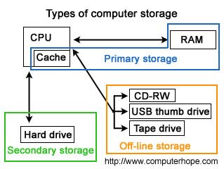
Secondary Storage Device

Slide 20
Secondary memory
Also known as auxiliary storage, secondary storage, or external memory, Auxiliary memory is a non-volatile memory (does not lose stored data when the device is powered down) that is not directly accessible by the CPU, because it is not accessed via the input/output channels (it is an external device). It is used to store a large amount of data at lesser cost per byte than primary memory.

Slide 21
Benefits of Secondary Storage:
Capacity. Organizations may store the equivalent of a roomful of data on sets of disks that take up less space than a breadbox.
Reliability. Data in secondary storage is basically safe, since secondary storage is physically reliable.
Convenience. With the help of a computer, authorized people can locate and access data quickly.
Cost. It is less expensive to store data on tape or disk than filing cabinets, but the greatest savings can be found in the speed and convenience of filing and retrieving data.

Slide 22
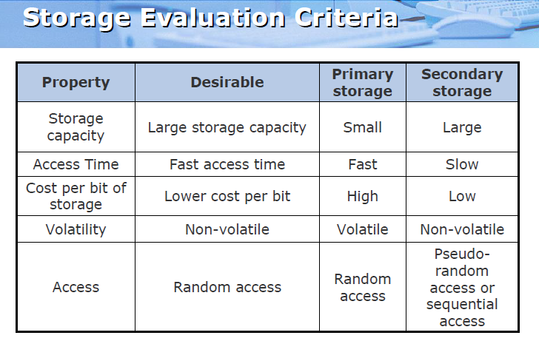

Slide 23
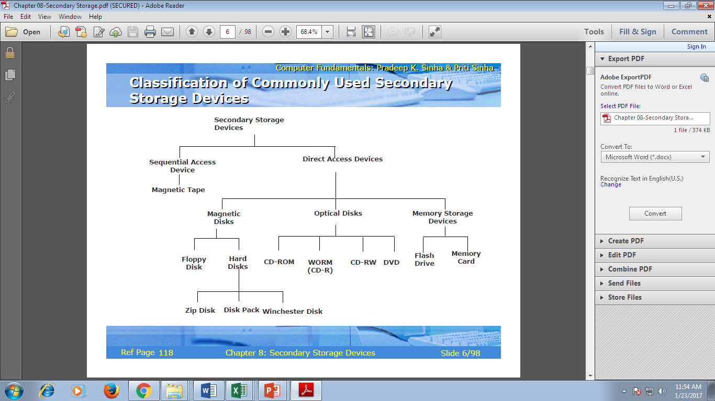

Slide 24
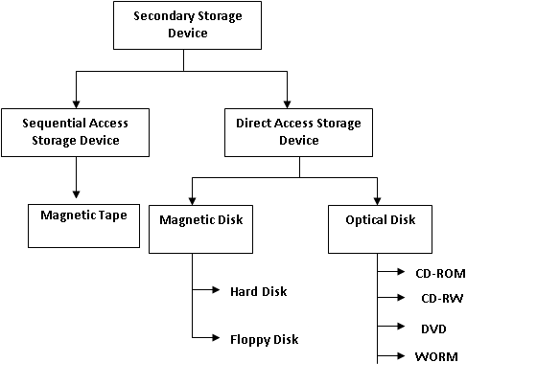

Slide 25
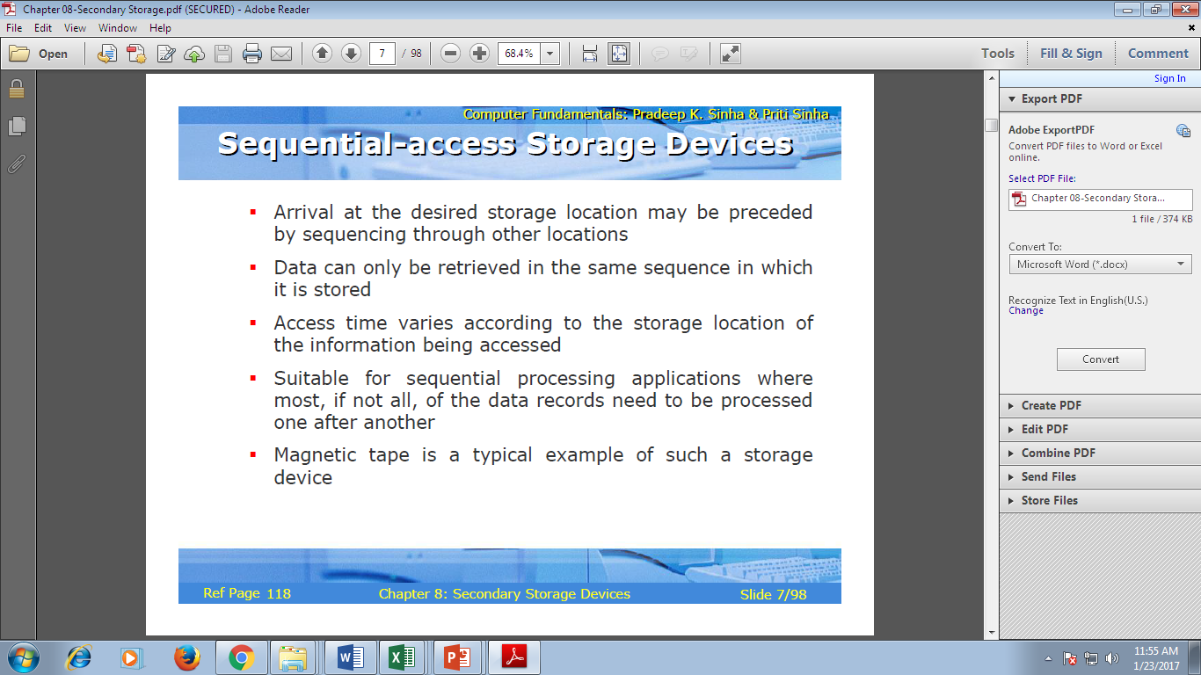

Slide 26
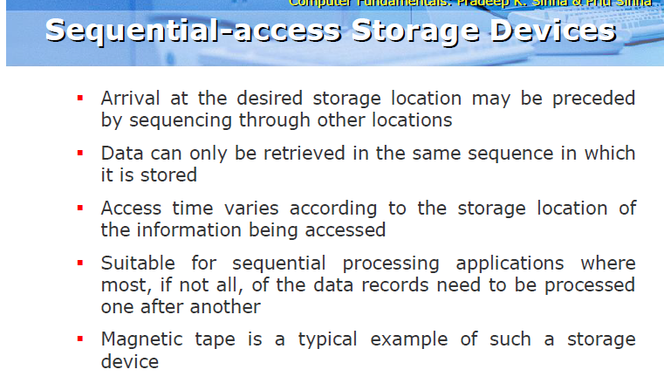

Slide 27
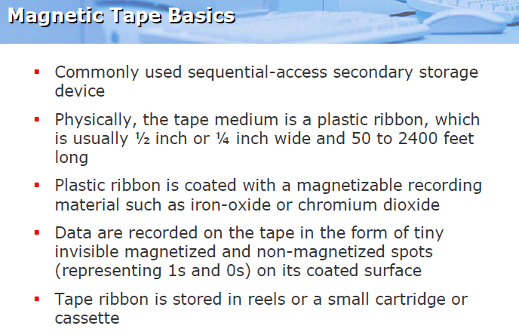

Slide 28
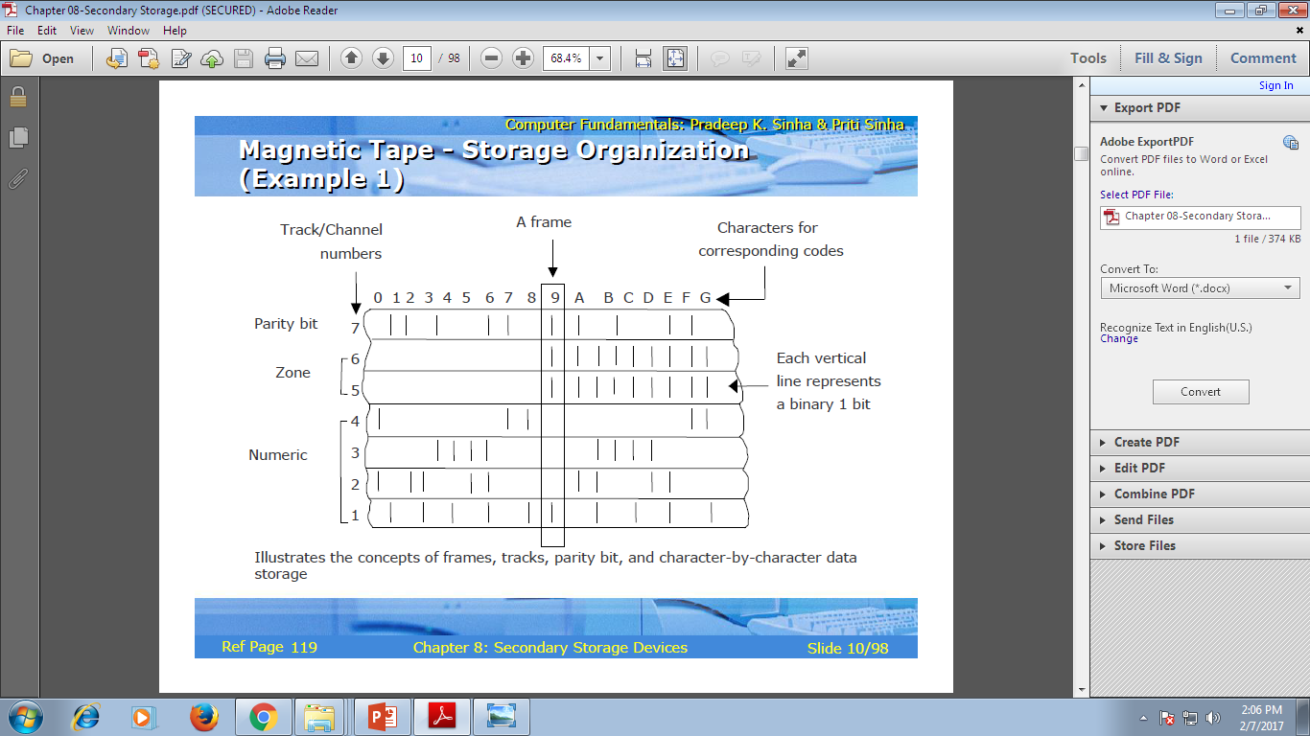
A tape is divided into vertical columns , called frames and horizontal rows called channels or tracks , older tapes had 7 tracks and used 6 bit BCD code. First six tracks are used for recording the 6 bits of BCD code and 7th track is used for recording parity bit. A parity bit or check bit is used to detect errors that may occur due to loss of bit from string of 6 or 8 bits during data input or output operations.

Slide 29
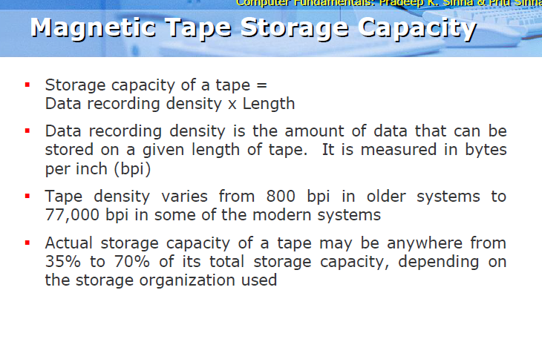

Slide 30
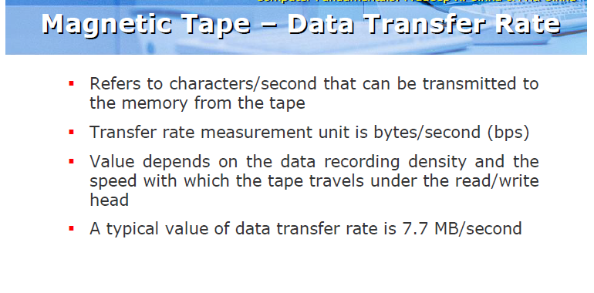

Slide 31
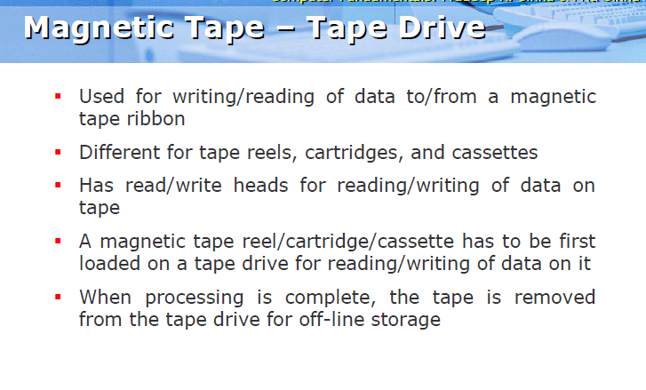

Slide 32
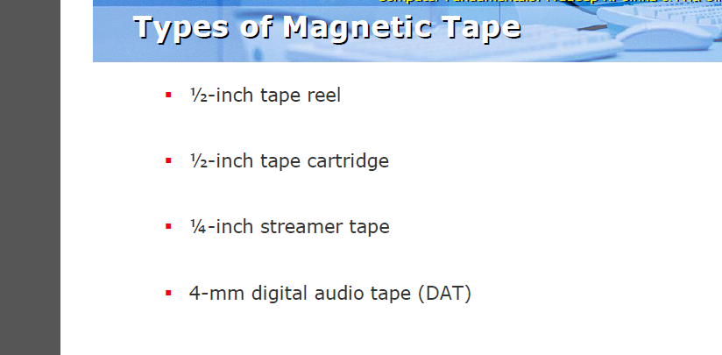

Slide 33
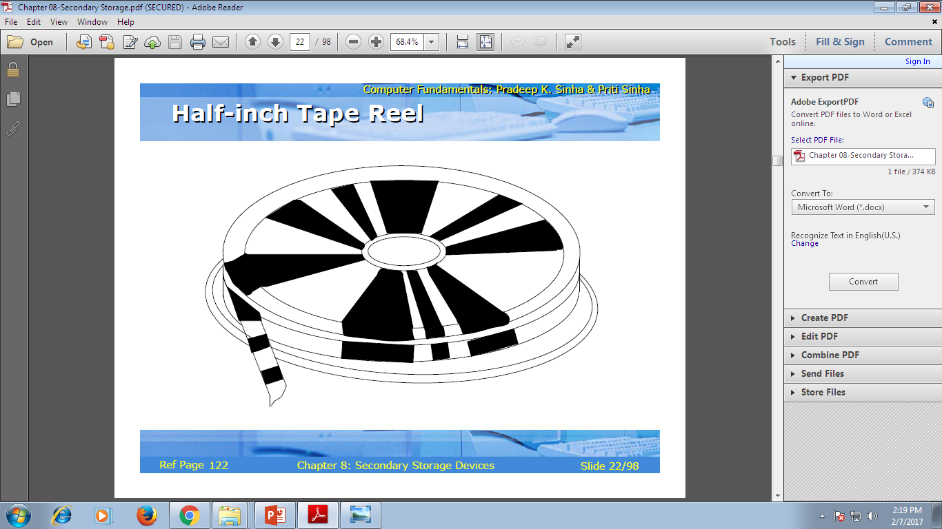

Slide 34
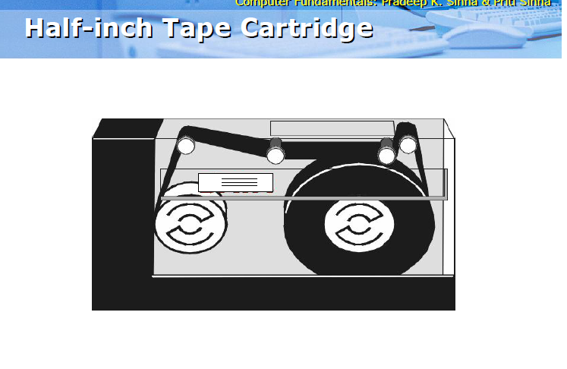

Slide 35
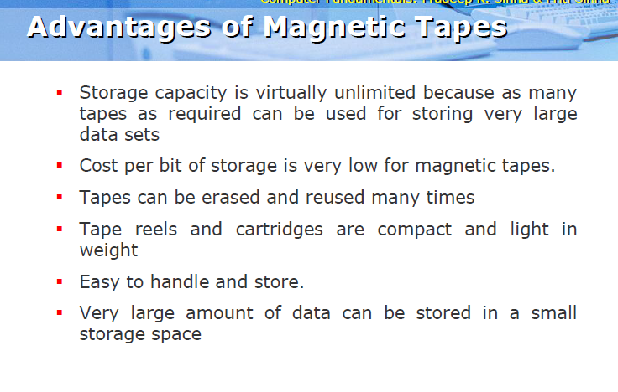

Slide 36


Slide 37
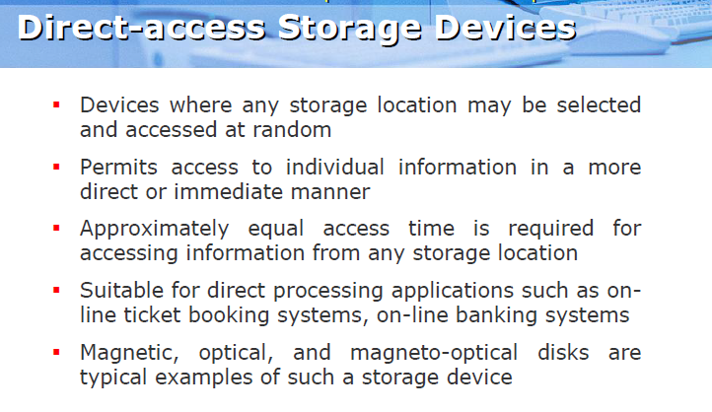

Slide 38
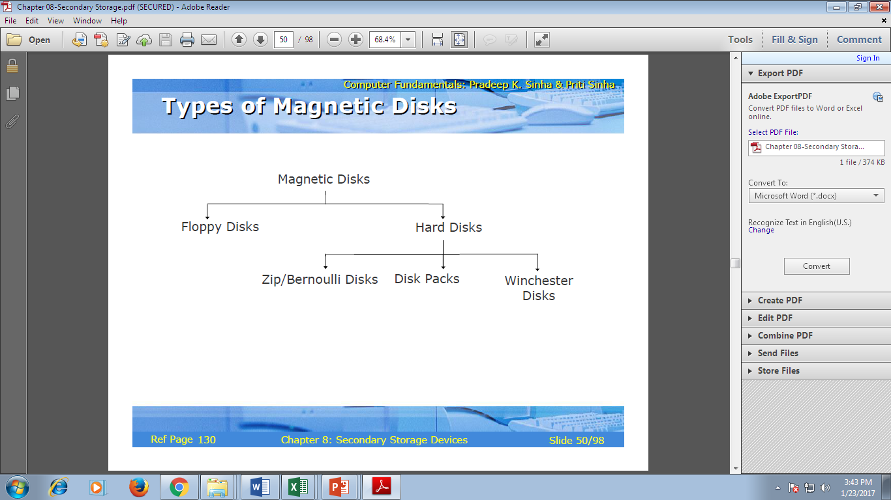

Slide 39
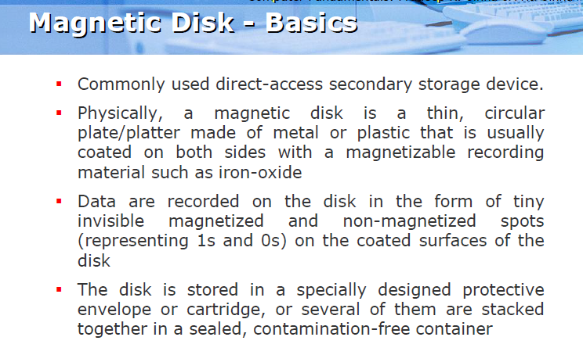

Slide 40
Hard Disk
A magnetic disk on which you can store computer data. The term hard is used to distinguish it from a soft, or floppy, disk. Hard disks hold more data and are faster than floppy disks. A hard disk, for example, can store anywhere from 10 to more than 100 gigabytes, whereas most floppies have a maximum storage capacity of 1.4 megabytes.
A single hard disk usually consists of several platters. Each platter requires two read/write heads, one for each side. All the read/write heads are attached to a single access arm so that they cannot move independently. Each platter has the same number of tracks, and a track location that cuts across all platters is called a cylinder.

Slide 41
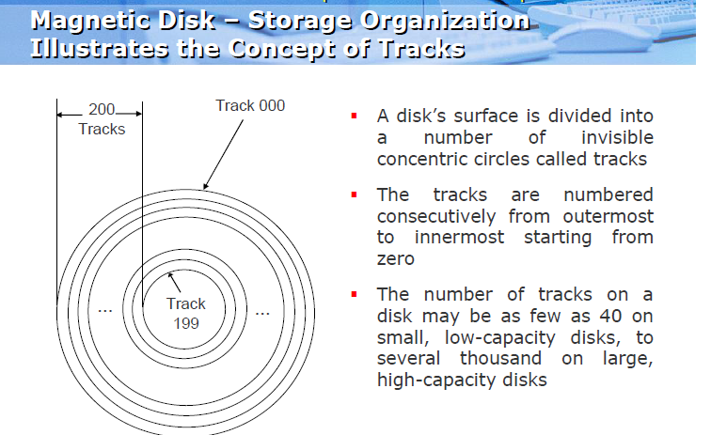

Slide 42
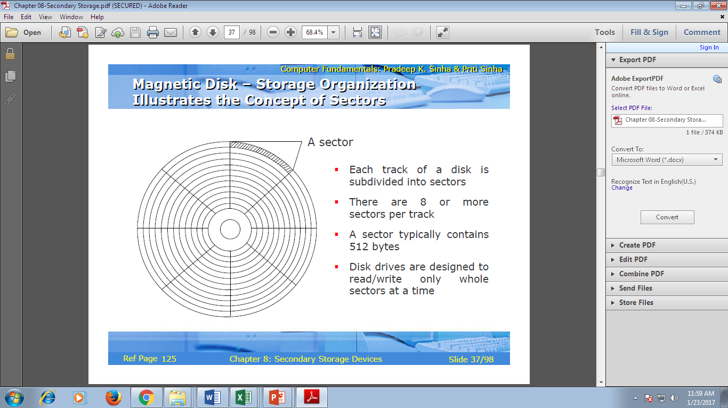

Slide 43
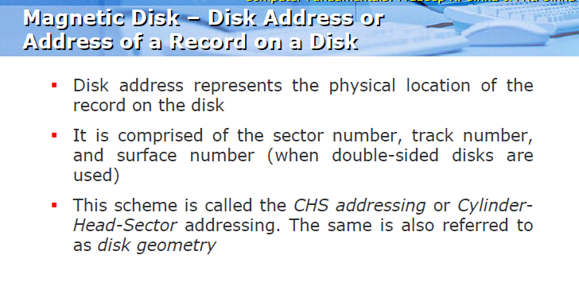

Slide 44


Slide 45
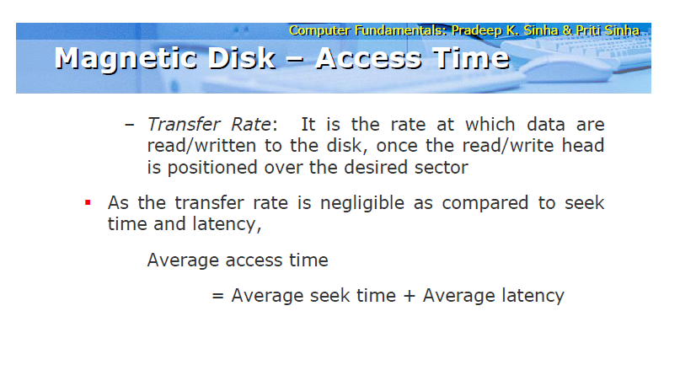

Slide 46
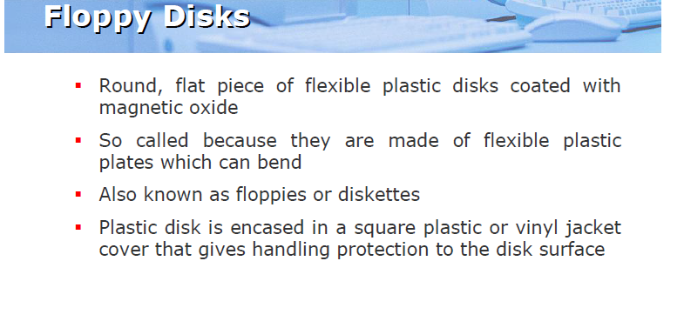

Slide 47
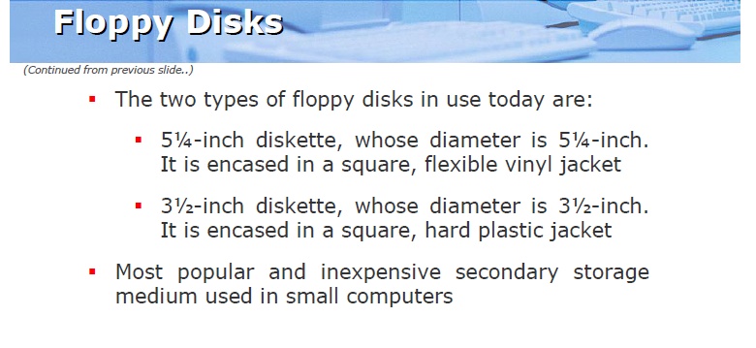

Slide 48
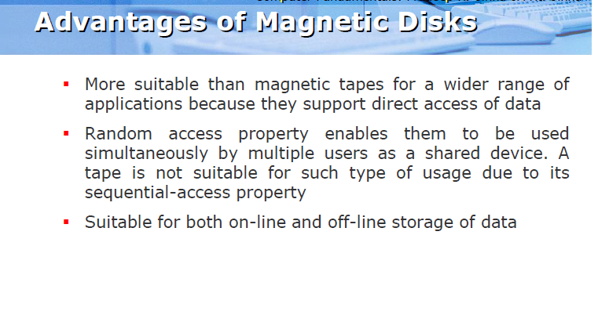

Slide 49
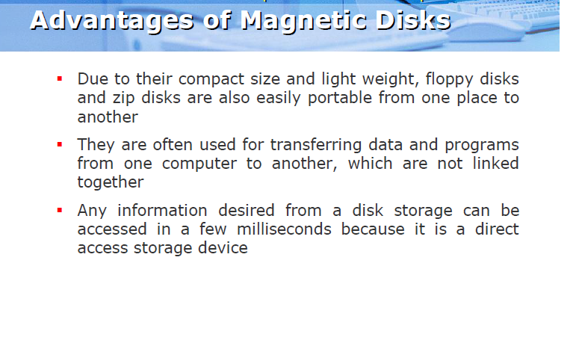

Slide 50
OPTICAL STORAGE DEVICES
Optical disk is flat, circular plastic plate coated with a thin layer of metal like aluminum, gold or silver on which data may be stored in form of highly reflective area and significantly less reflective area from which data is read or written into through a laser beam.
These disks are capable of storing enormous amount of data in a limited amount of space. Example-CD,DVD
Optical disk comes in various sizes and capacity. A CD can store 600-700 MB of data while DVD can store data in GB.

Slide 51
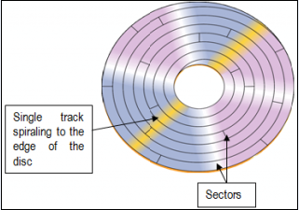

Slide 52
ACCESS MECHANISM
Laser beam technology is used for reading/writing of data. This technology uses 2 laser beam source of different intensity. The greater intensity laser beam is used to write data on the surface of platter by turning it on and off at a varying rate so that the tiny pits are burnt into the surface of disk. The lesser intensity beam is required to read the data which is strongly reflected by the coated surface called “Pit”. The beginning or end of pit represent 1 and no change in elevation between intervals represent 0.

Slide 53
Read-Only Discs: CD-ROM and DVD-ROM Discs
CD-ROM (compact disc read-only memory) is an abbreviation of Compact Disc Read-Only Memory. A CD-ROM is a CD that contains computer data, which cannot be rewritten. In computers, CD-ROM is the most commonly used optical storage technology. CD-ROM is a compact disc that contains information, which is accessible by a computer. It is composed of polycarbonate plastic, thin reflective metal layers, made of aluminum and a lacquer coating. Data is stored on the disc as a series of light and dark pits; the light portion refers to the spaces between the pits. A laser beam reads the pits and the data can be accessed. A standard 120 mm CD-ROM holds up to 700 MB of data, or about 70 minutes of audio.

Slide 54
DVD-ROM
(
(Digital versatile disc read-only memory). DVD-ROM is an optical disc storage media format that can be used for data storage, which includes movies with high video and sound quality. DVD-ROM is a non-volatile optical storage medium similar to CD-ROM, which contains computer data that cannot be erased or rewritten. These DVDs are read-only disks that have storage capacity for 133 minutes of high quality video, in format, and audio full- length feature film. The discs are pressed in a similar fashion as the CDs. The reflective surface is gold or silver colored. DVD-ROM can be accessed using a DVD-ROM drive attached to the personal computer. A standard DVD disc stores up to 9.4 GB of data.

Slide 55
Recordable Discs: CD-R, DVD-R, and DVD+R Discs
Recordable discs can be written to, but the discs cannot be erased and reused. Recordable CDs are referred to as CD-R discs; recordable DVDs are called DVD-R or DVD+R discs, depending on the standard being used (different optical disc and drive manufacturers support different standards).

Slide 56
Rewritable Discs: CD-RW, DVD-RW
The newer rewritable discs can be recorded on, erased, and overwritten just like a magnetic disk. The most common types of rewritable optical media are CD-RW, DVD-RW, and DVD+RW discs. CD-RW discs are written to using a CD-RW drive and can be read by most CD and DVD drives. DVD-RW discs and DVD+RW discs are recorded using a DVD-RW drive or DVD+RW drive, respectively, and can be read by most DVD drives. CD-RW discs hold 700 MB, DVD+RW and DVD-RW discs hold 4.7 GB per side, and DVD-RAM discs typically hold between 2.6 and 9.4 GB, depending on the speed of the disc and the number of sides used.

